Slide 1
ASU Pilot Instruction Manual

Slide 2
Table of Contents
Getting Started
Starting a Mission
Mission Customization
Minecraft Graphics
3
15
21
28

Slide 3
Getting Started

Slide 4
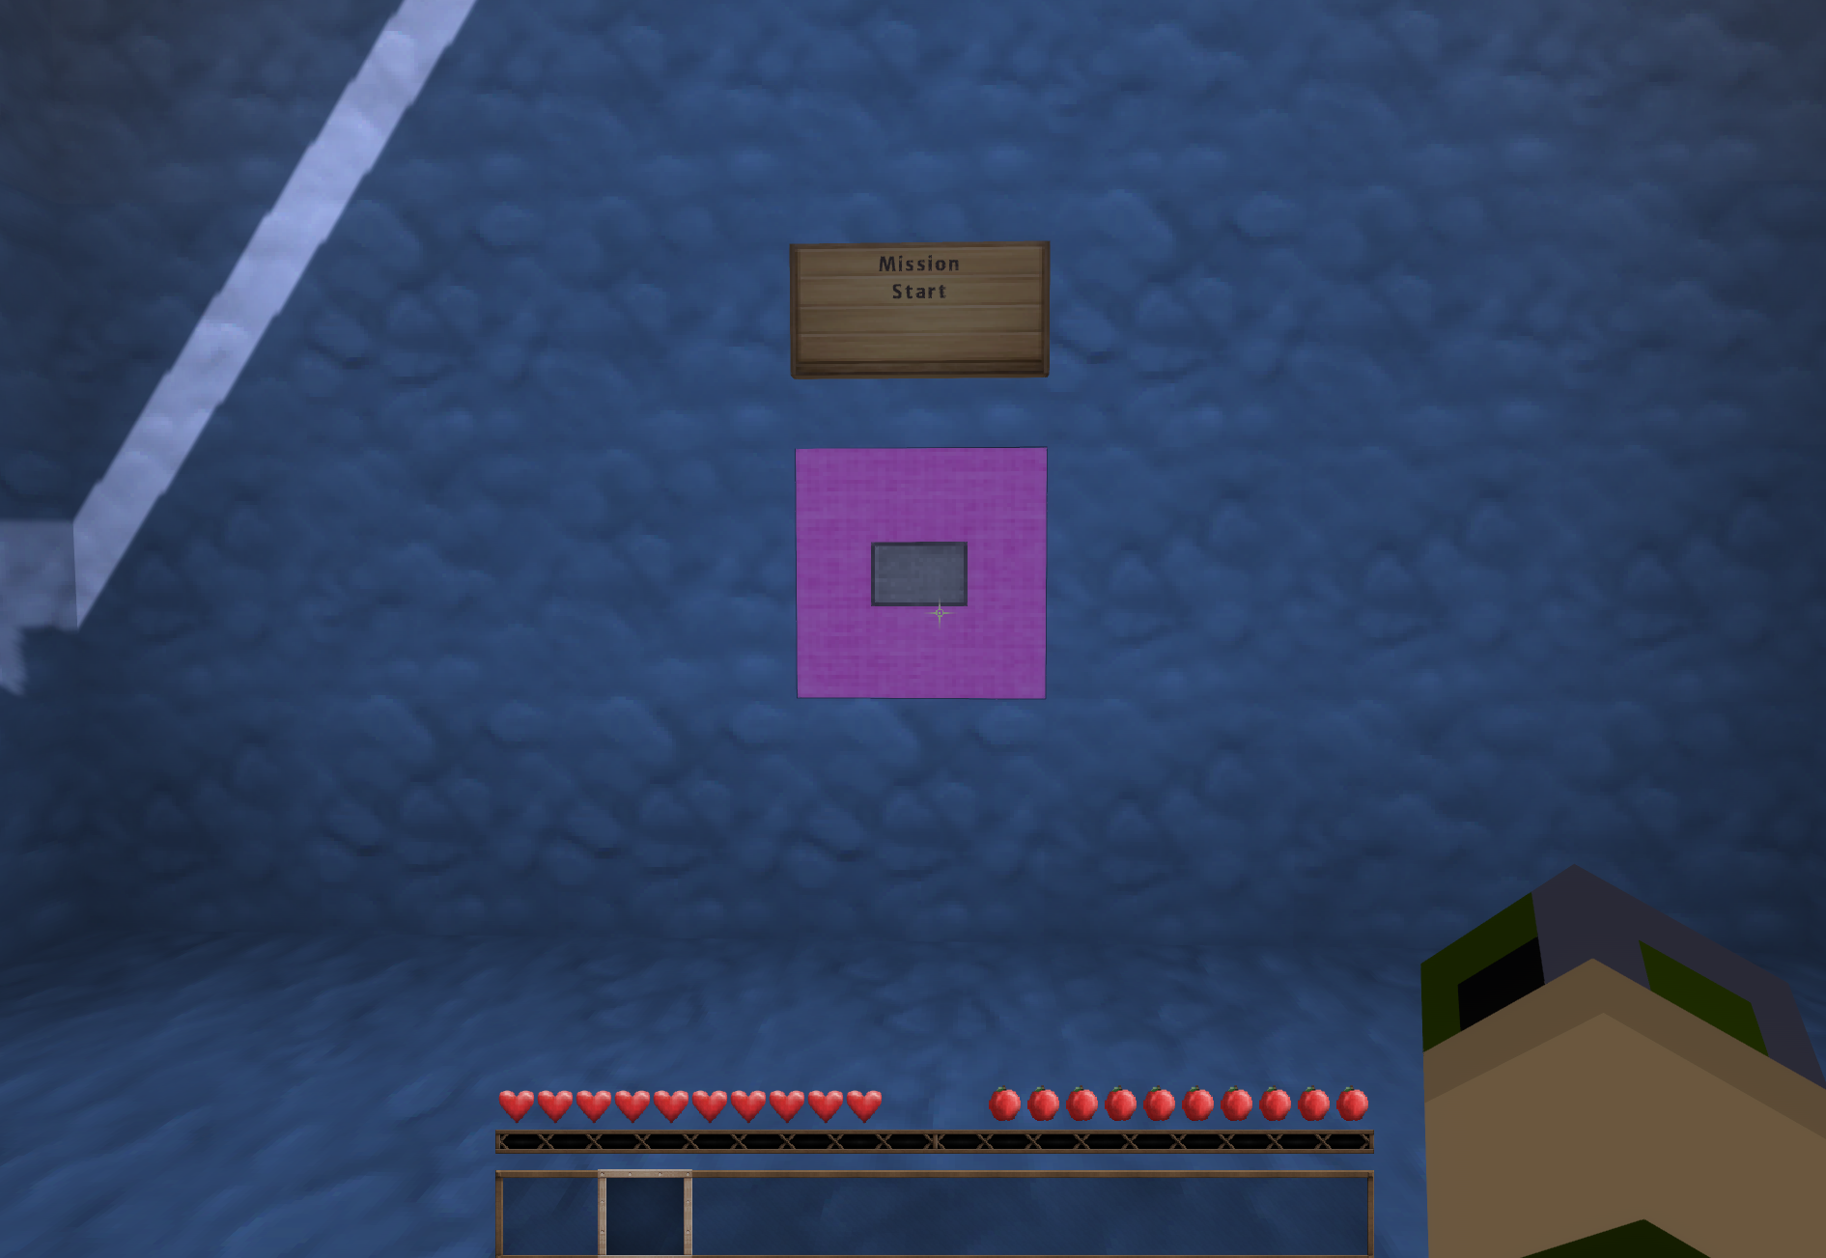
Spawning In
Upon loading the world you will be placed into the start room
If you do not appear here you can teleport to this location with the following command
/tp PlayerName -2186 52 177
In the code above, substitute PlayerName with your in-game character name

Slide 5
Mission Defaults
By default, the following features are enabled:
Dog Bark
Observer Map Player Trail
Player Map Paper Trail
Mission Timer
Static Fire/Collapse Perturbations
Critical Victim Fatalities
Player Glow Effect
First Aid Kit
Victim Scoring

Slide 6
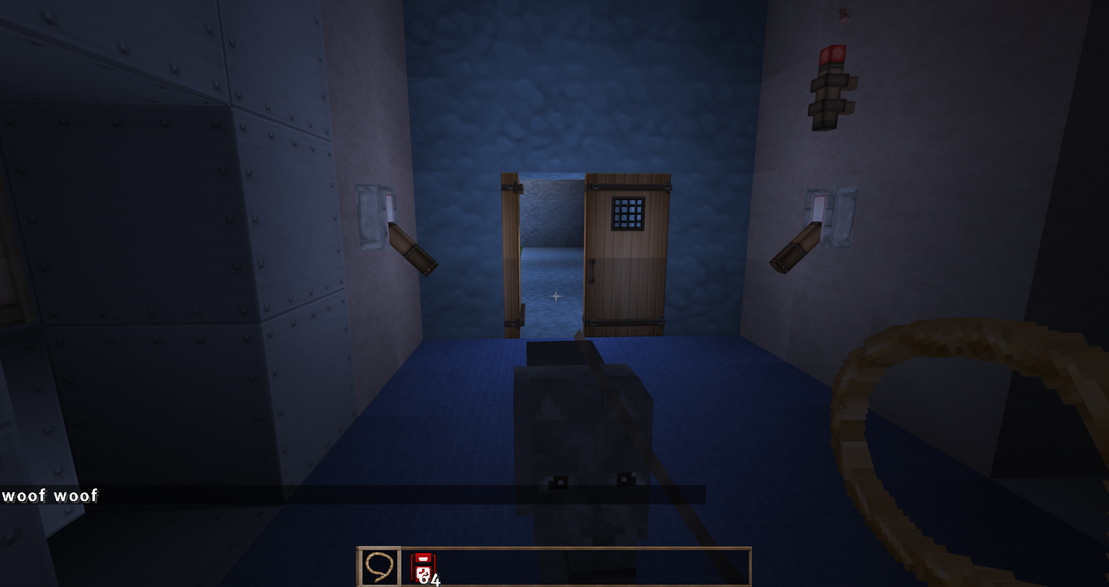
Dog Bark
When the dog is in front of a door containing a victim it will bark
The dog will bark twice (woof woof) if the victim is yellow, and once (woof) it if is green
The player is given a lead (leash) to attach to the dog

Slide 7
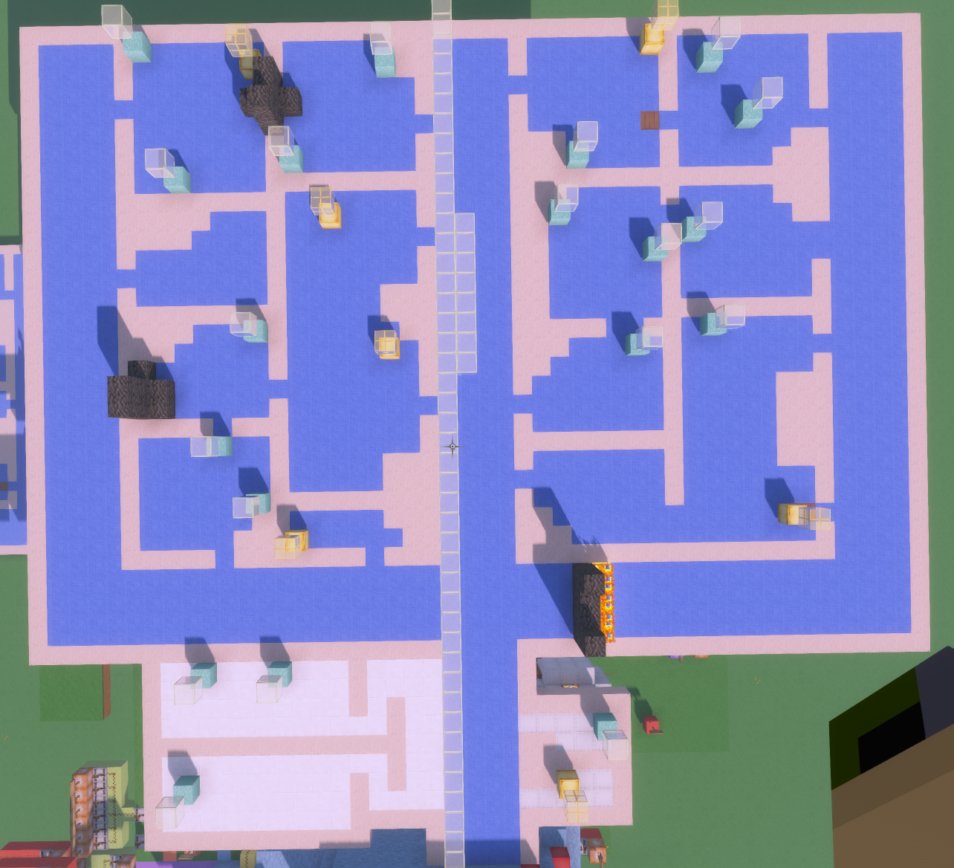
Observer Map Player Trail
A player trail is placed on top of the roof to show their movements throughout the building
To get there, a player must be in observer mode and fly over the building (roughly -2131 88 175)

Slide 8
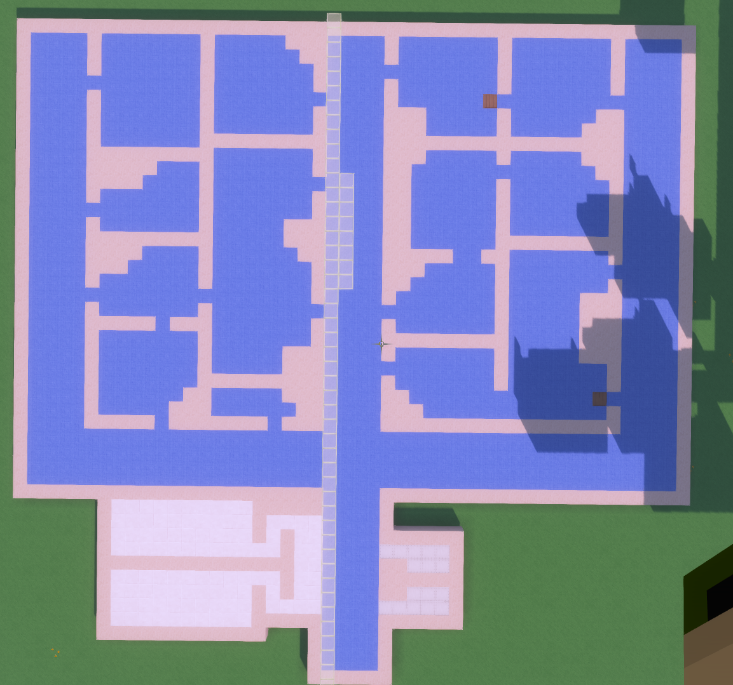
Player Map Player Trail
A player trail is placed on a building floorplan located on the side of the building
If desired, an observer can be placed over this area for players to use as a map that shows where they’ve been in the environment
This player map does not include victim or perturbation locations

Slide 9
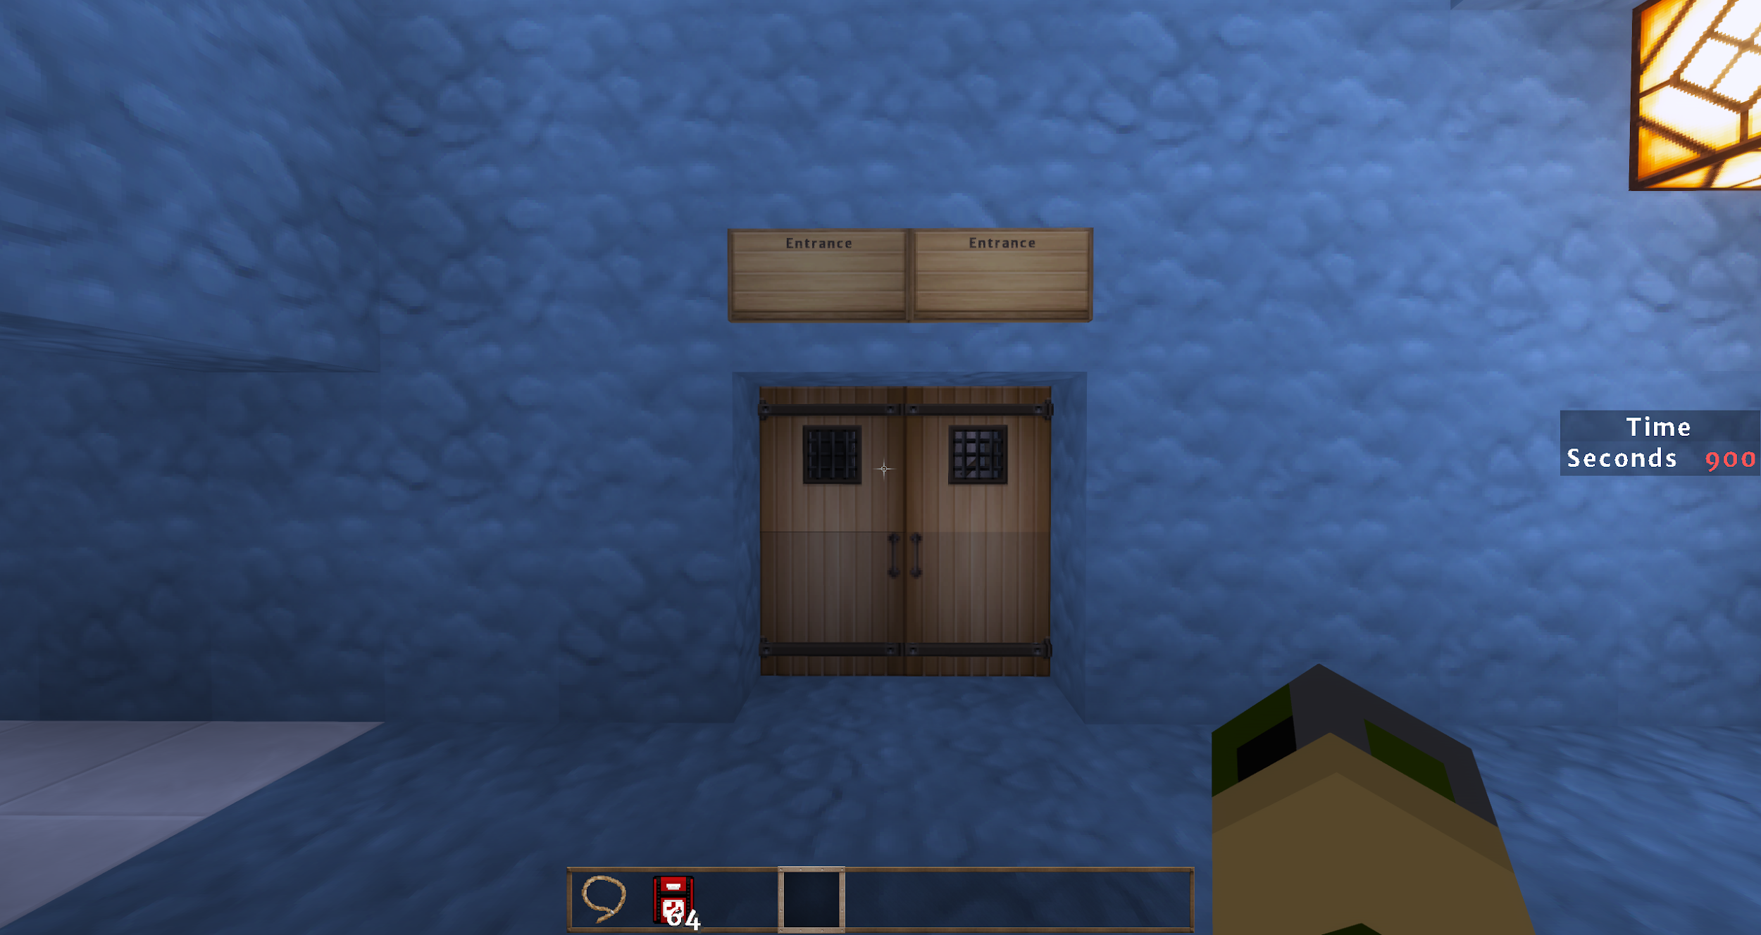
Mission Timer
The current pilot mission is scheduled to last 15 minutes
A timer is placed on the side of the screen and counts down in seconds

Slide 10
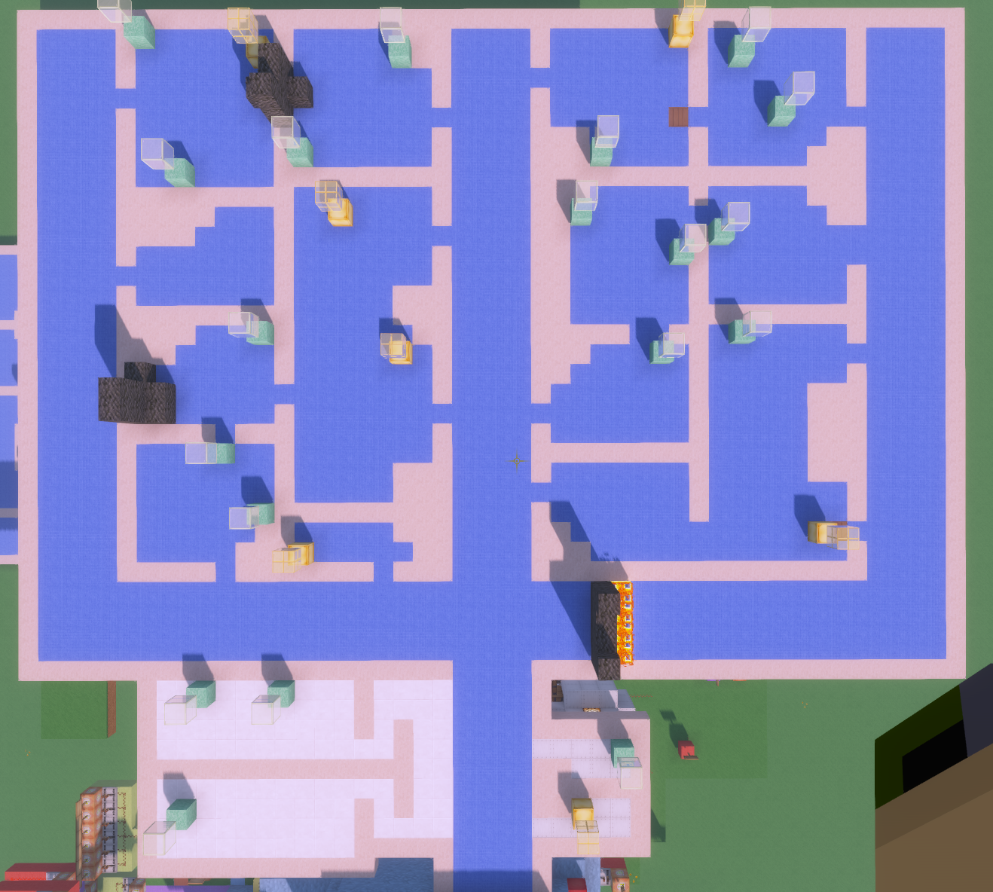
Static Fire/Collapse Perturbations
Static blockages are placed at the beginning of the mission
Collapse/fire blocking access to the right hallway
Collapse blocking the main entrance to Room 203
Collapse blocking access from Room 207 to Room 210
The collapses are made from unbreakable blocks forcing players to go around them

Slide 11
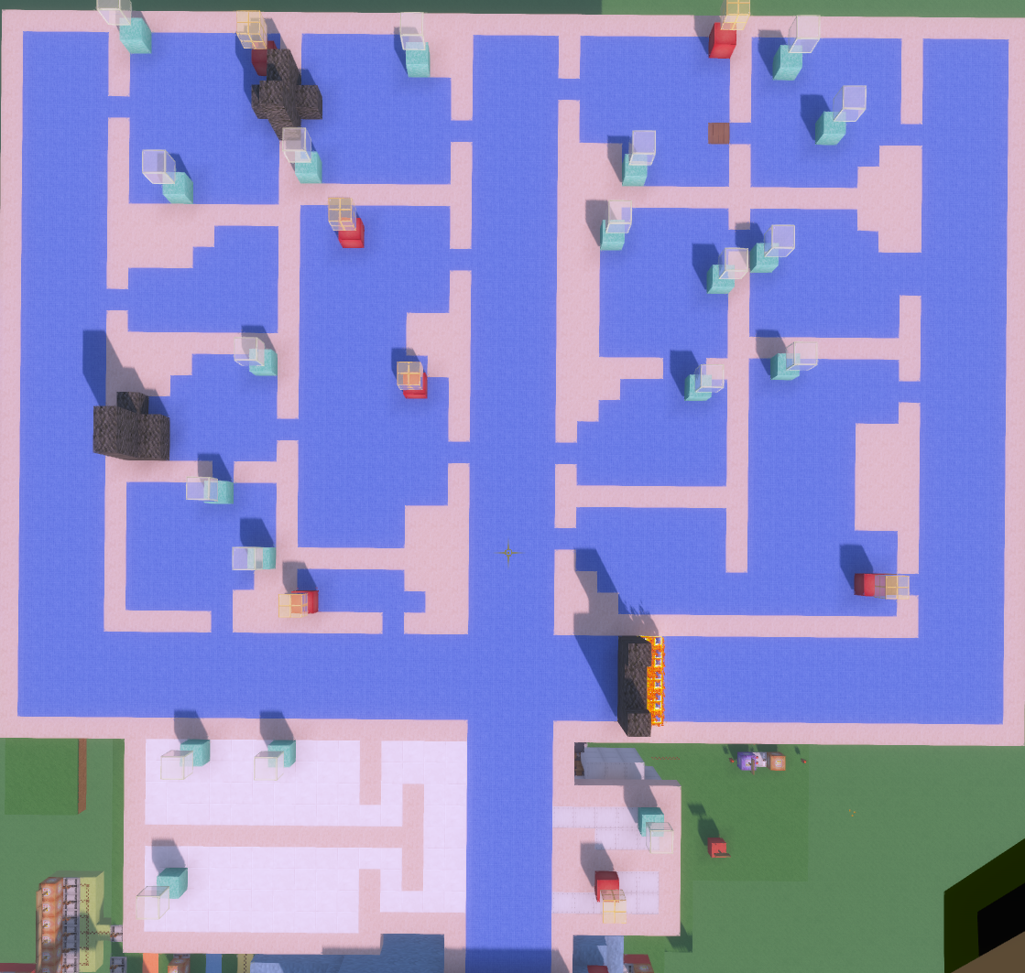
Critical Victim Fatalities
Yellow victims will die after 7 minutes and turn red
“All Critically Injured Victims Have Succumb To Their Injuries” will be pushed across the text chat at 7 minutes

Slide 12
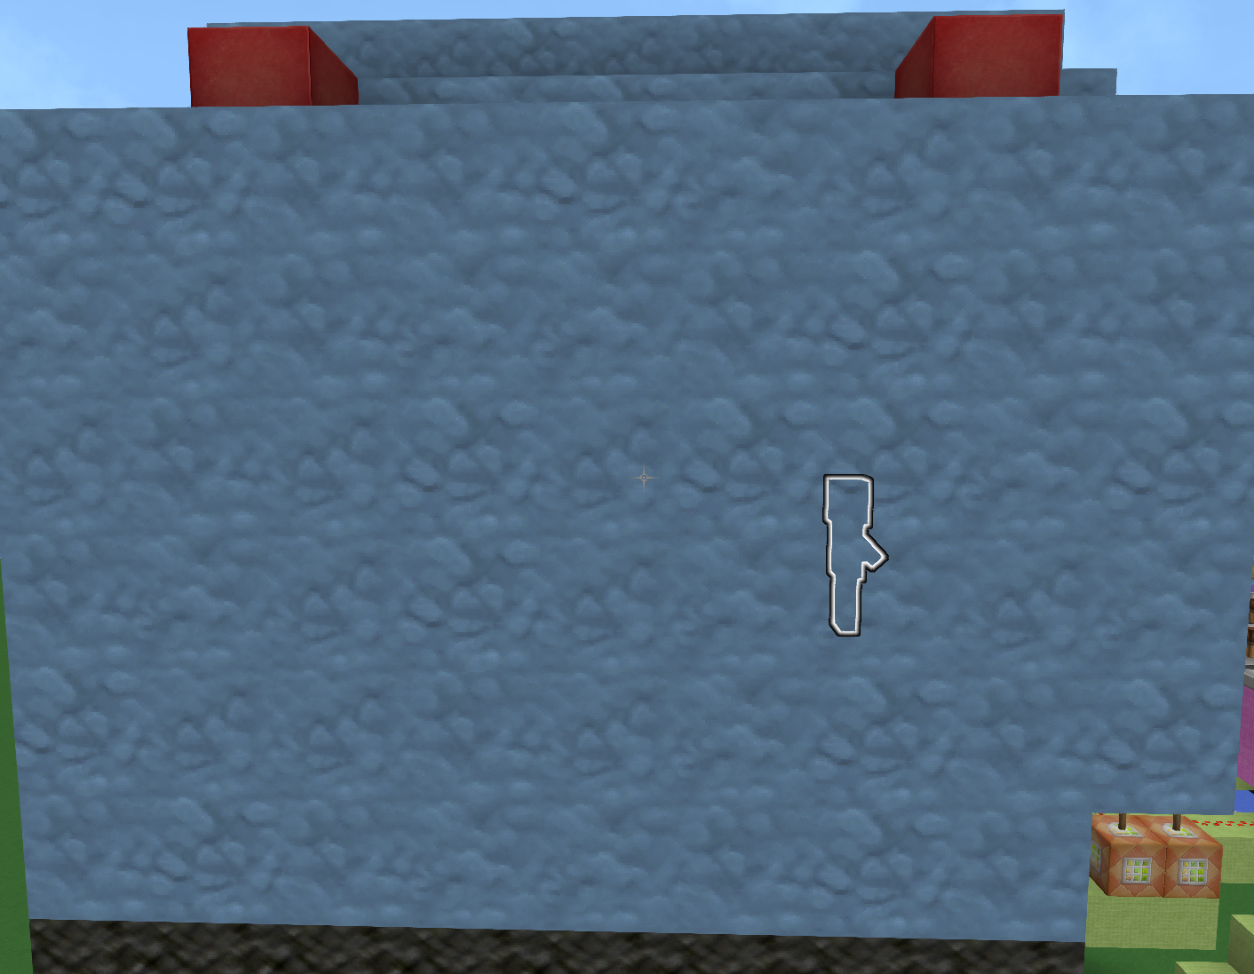
Player Glow Effect
Gives the player a glow effect that outlines them through walls
Glow effect is used in conjunction with the observer map player trail

Slide 13
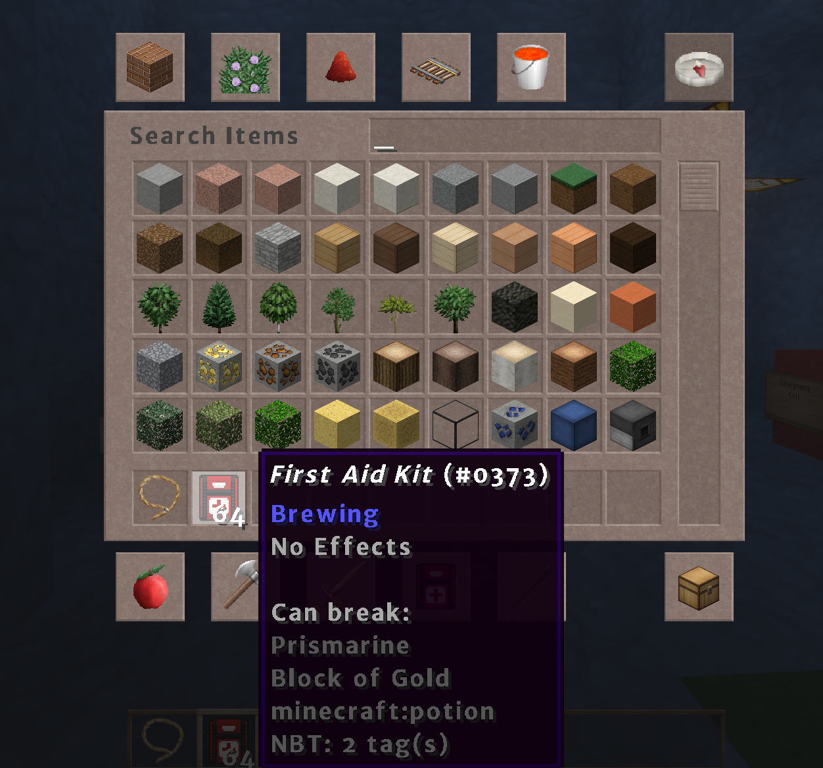
First Aid Kit
The player is given one stack (64) of First Aid Kits to use to triage victims
By default, once the mission start button is pressed the game is placed into adventure mode
The rules of adventure mode prevent players from breaking blocks unless given a specific tool
The First Aid Kit MUST be equipped for players to break the victim blocks
*The First Aid Kit allows players to break Prismarine (green victims) and Blocks of Gold (yellow victims) only.

Slide 14
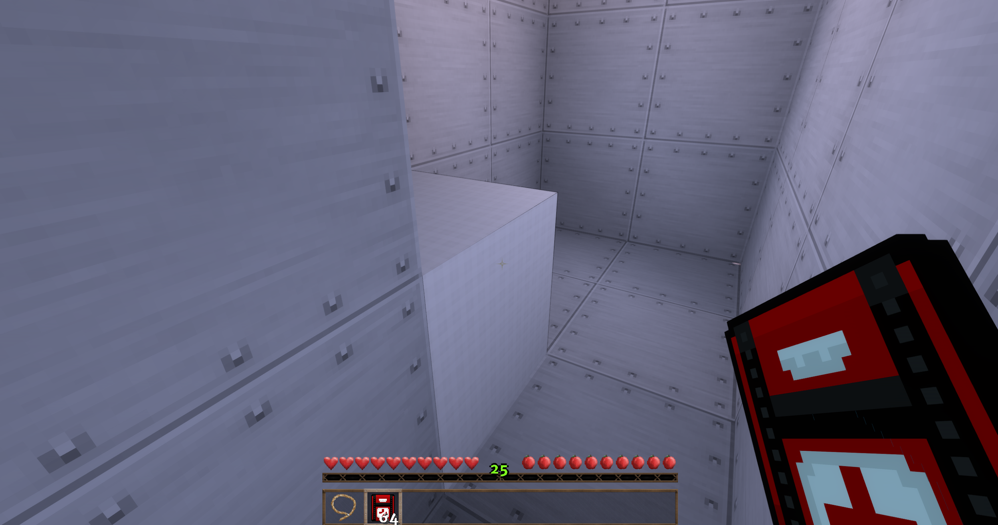
Victim Scoring
Players receive points for triaging victims
Green victims are worth 10 points
Yellow victims are worth 25 points
There are a total of 365 points available on the map
If the yellow victims die they no longer provide points

Slide 15
Starting a Mission

Slide 16
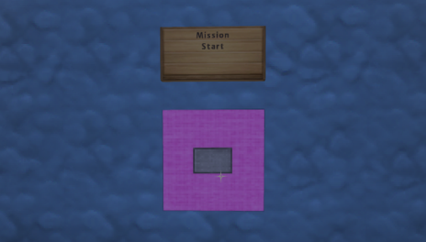
Mission Start
The mission can be started by pressing the Mission Start button in the start room

Slide 17
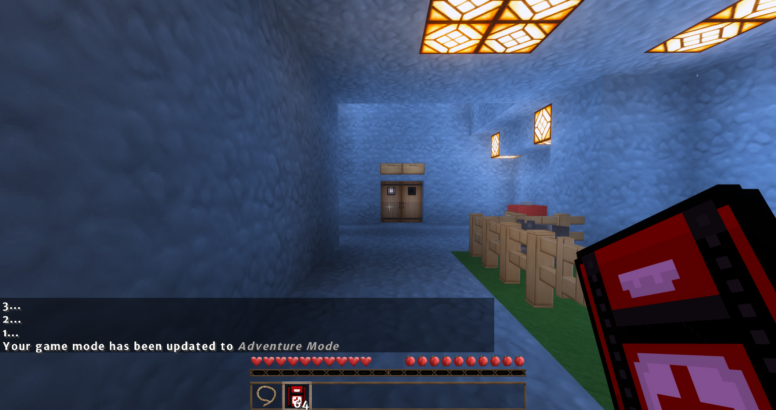
Teleportation to Staging Area
After pressing the mission start button, a 3 second countdown will begin, after which the player will be teleported to the staging area
Pressing the mission start button gives the player 1 lead (leash), 64 First Aid Kits, and applies the Glow Effect

Slide 18
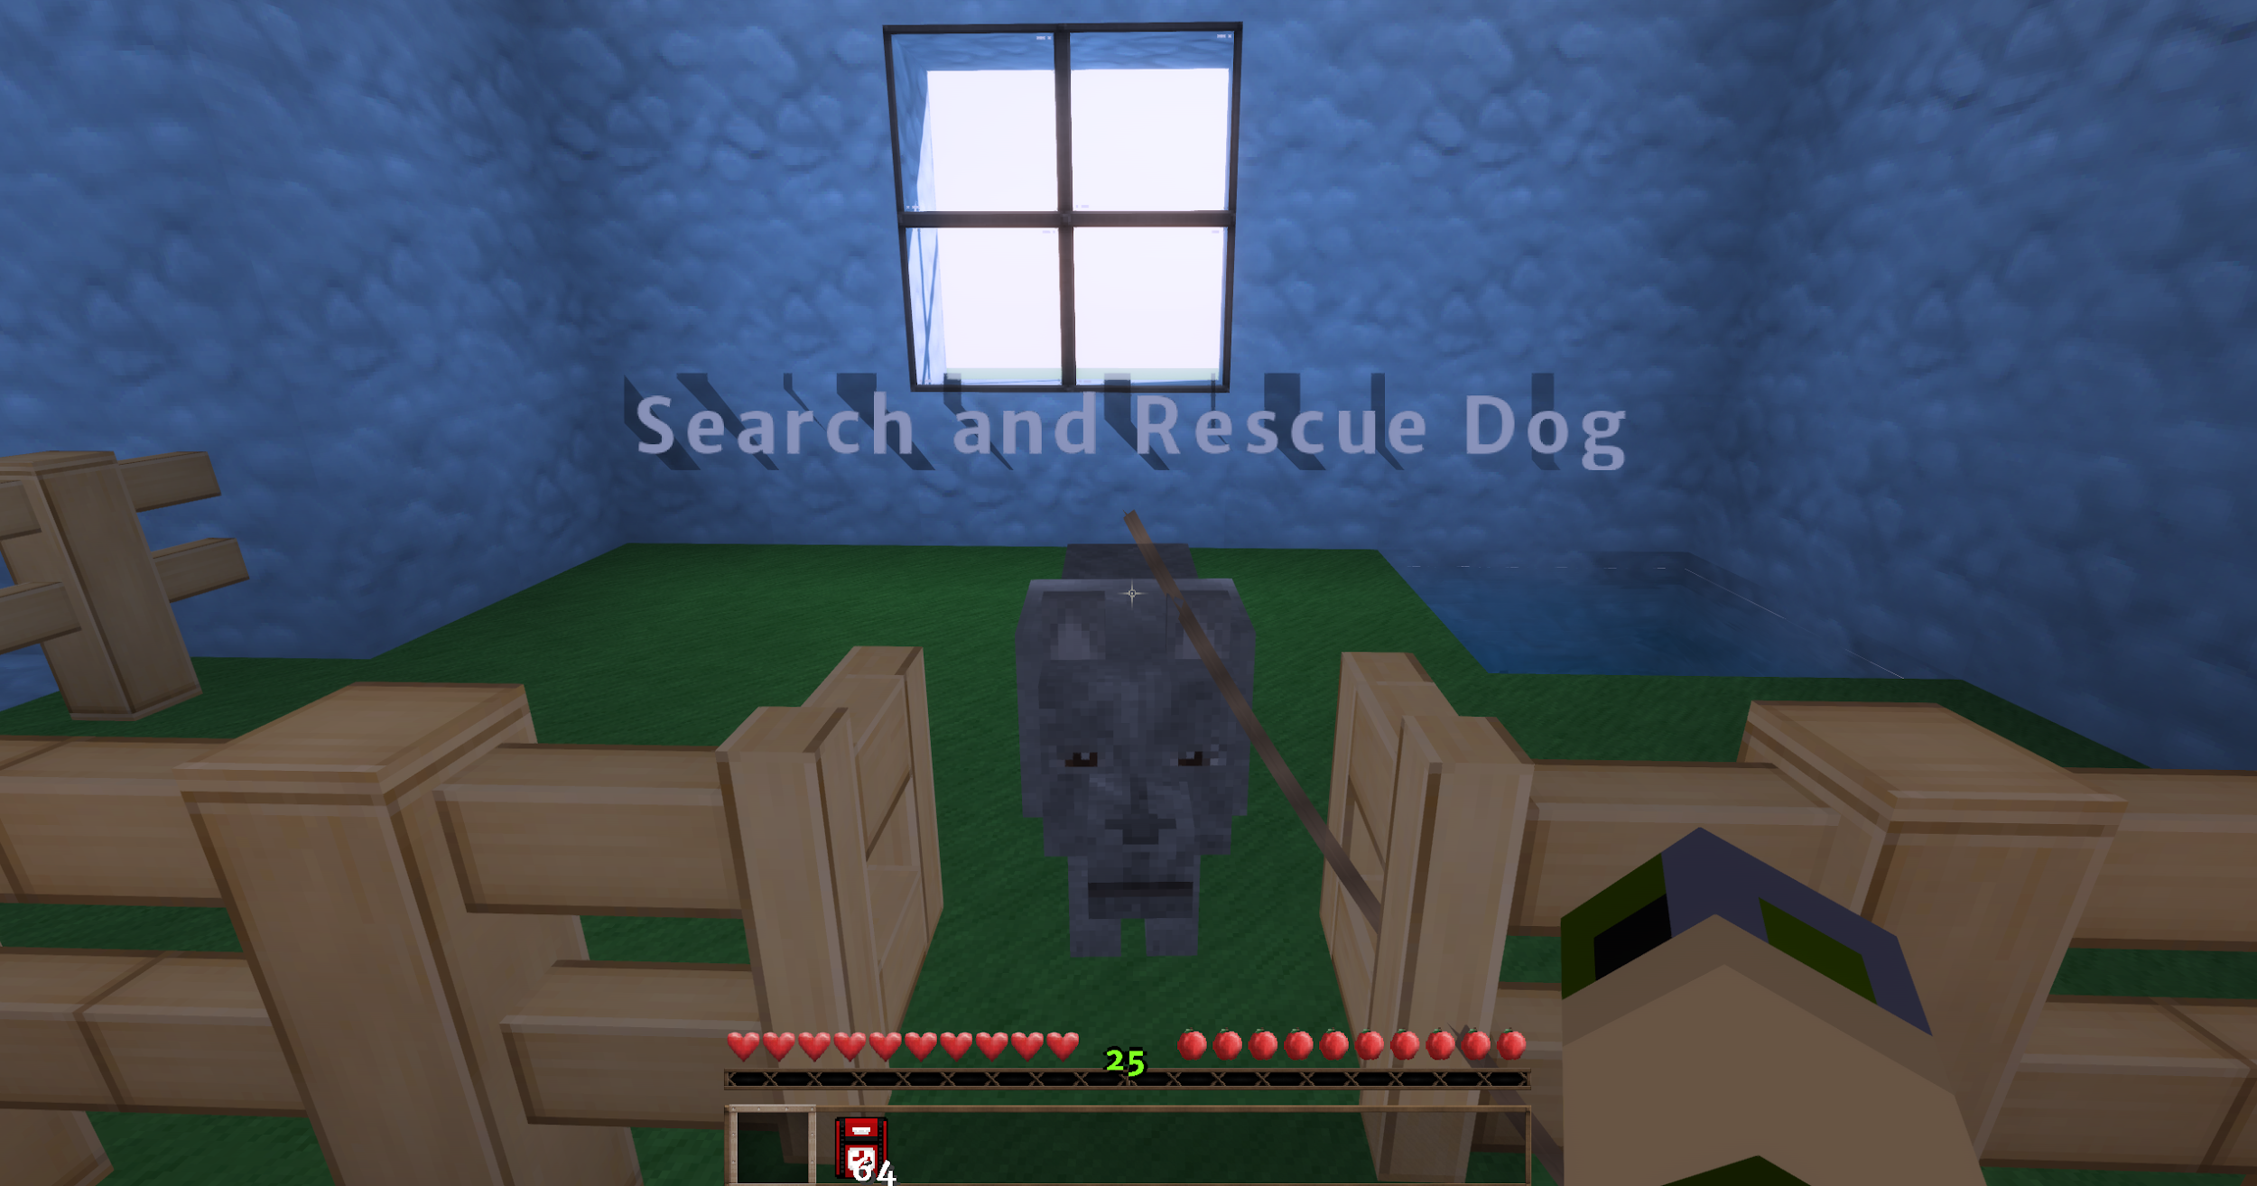
Getting a Dog
The dog is located on the right side of the staging area
To retrieve the dog:
Right click the gate to open it
With the lead equipped, right click the dog
The lead will attach to the dog and be removed from your inventory
The dog will now follow you

Slide 19
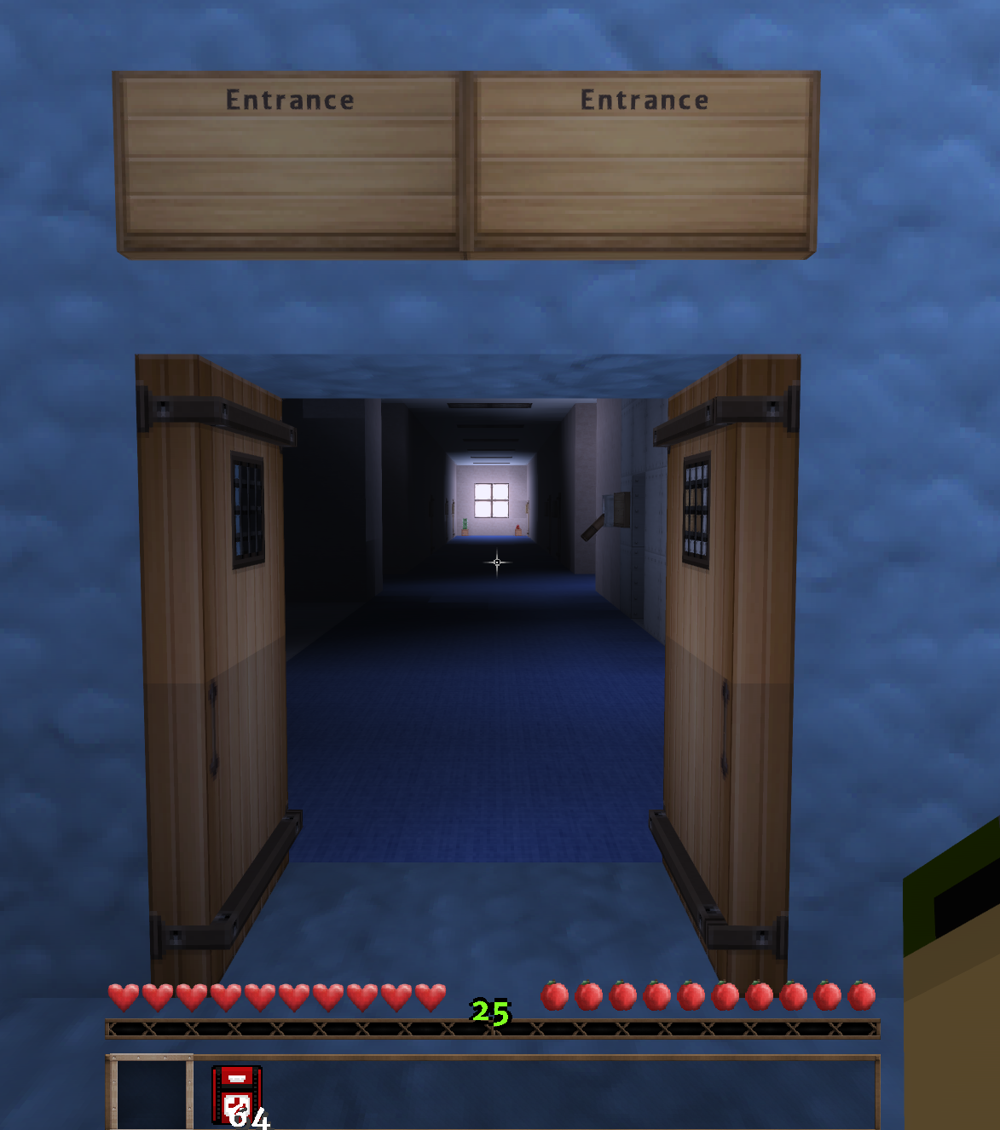
Enter the Building
With the dog equipped, walk to the entrance, open the doors, and go save some lives

Slide 20
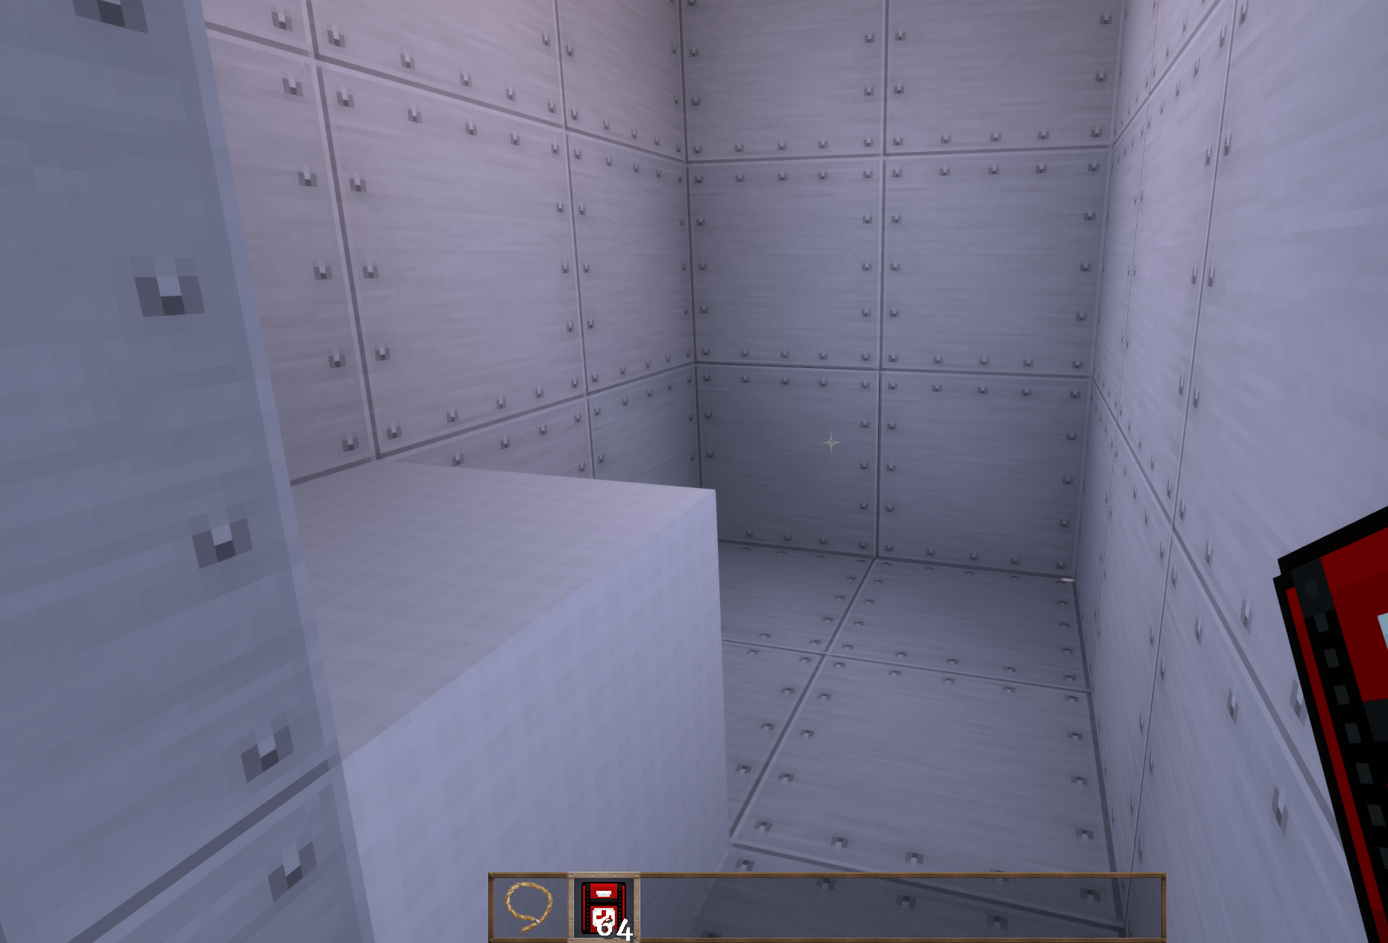
Victim Triage
Victims successfully triaged will turn white

Slide 21
Mission Customization

Slide 22
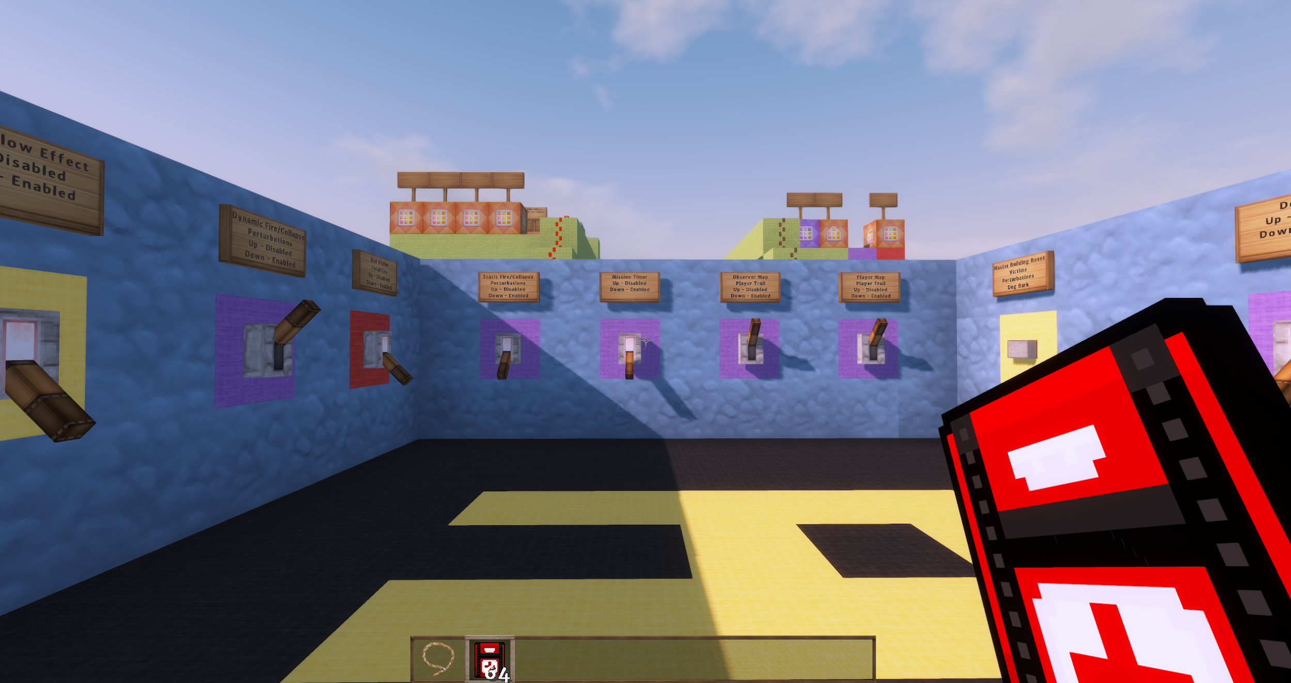
The Command Center
To allow mission customization to fit performer needs, all mission defaults can be enabled/disabled from the Command Center
The Command Center can be reached by teleportation
/tp PlayerName -2166 46 166

Slide 23
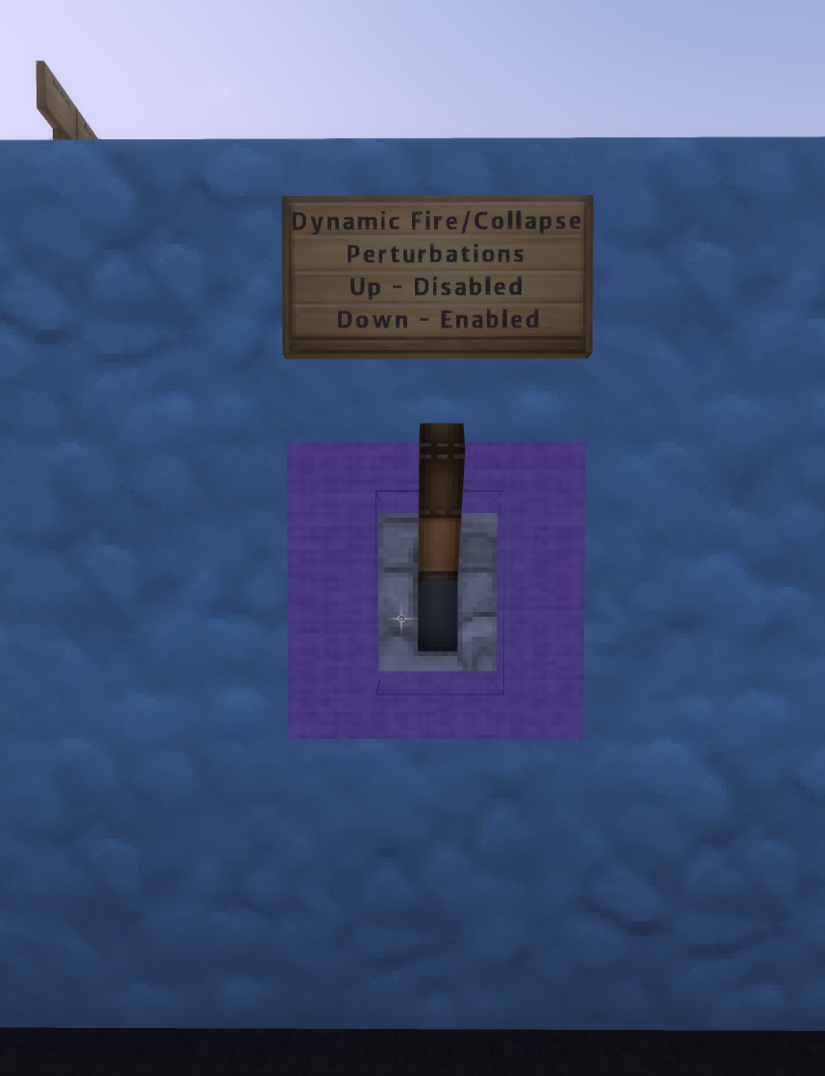
Dynamic Fire/Collapse Perturbations
While disabled by default, the Command Center has the option to enable dynamic fire/collapse perturbations as seen in the kickoff meeting

Slide 24
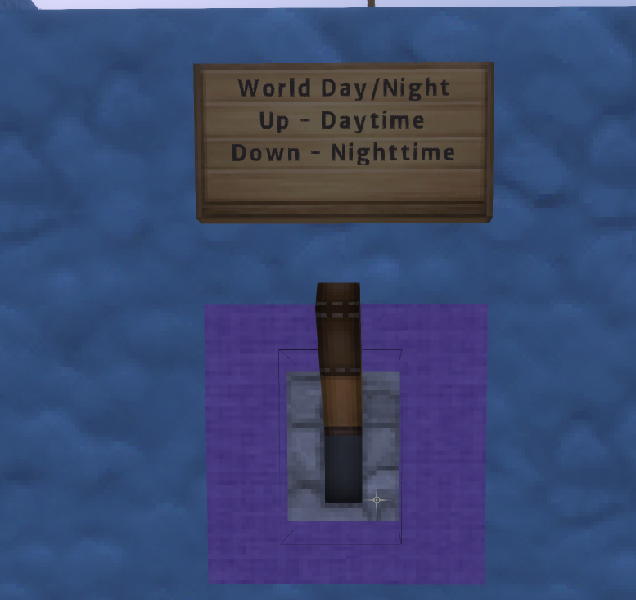
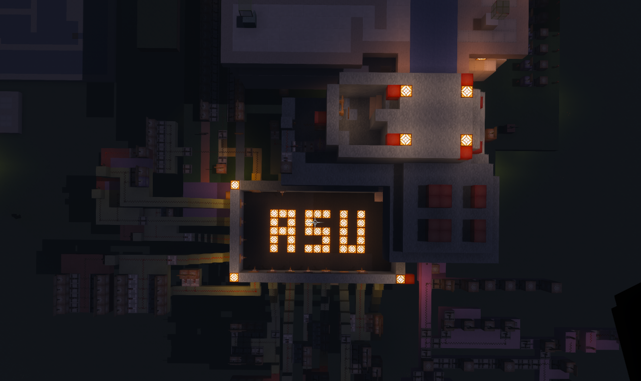
World Day/Night
While also disabled by default, the time of day can be toggled within the Command Center
If night mode is activated, the player will be given a torch at the start of the mission to use to see throughout the environment
Tell players not to turn on light switches

Slide 25
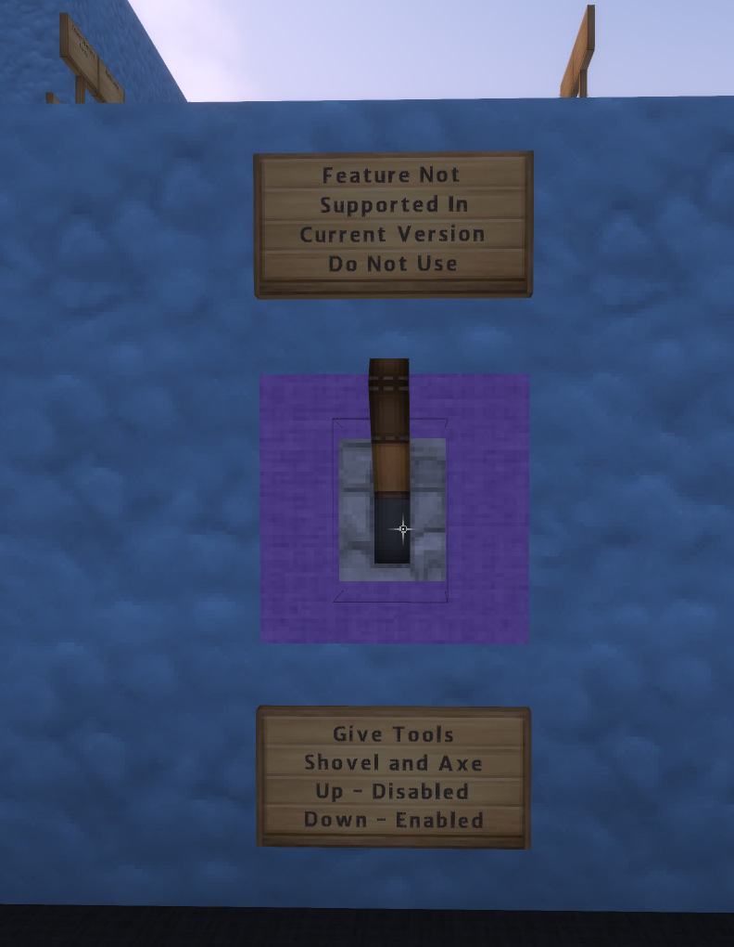
Shovel and Axe
While not officially supported in the ASU pilot world, the option to give players a shovel and axe is provided in the Command Center
Similar to the kickoff, players may use these tools to clear perturbations

Slide 26
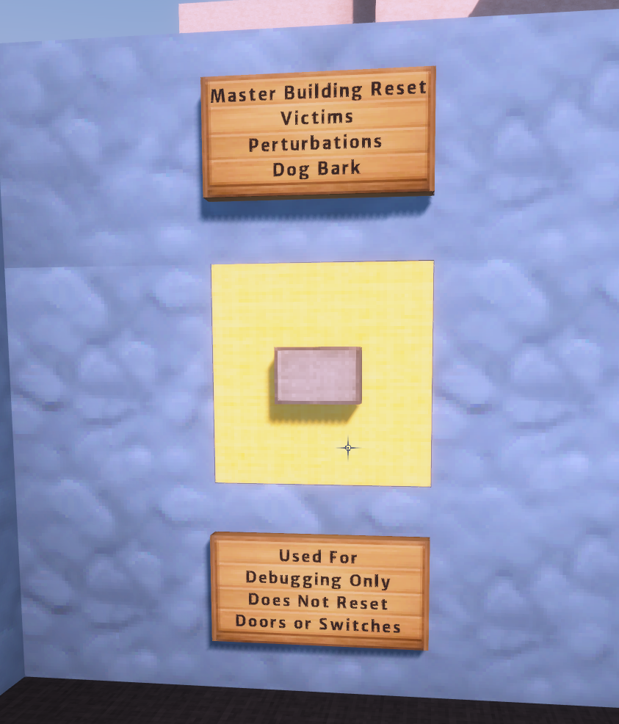
Building Reset
A reset switch is provided for use when debugging only
When running an actual study it’s best to give each participant a fresh copy of the world rather than relying on the reset switch

Slide 27
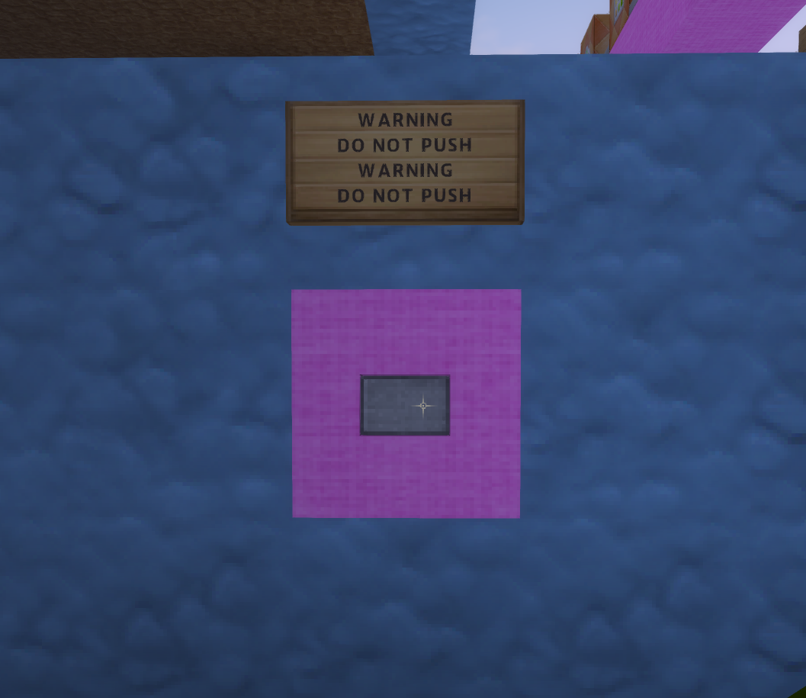
???
DO NOT PUSH THIS BUTTON

Slide 28
Minecraft Graphics

Slide 29
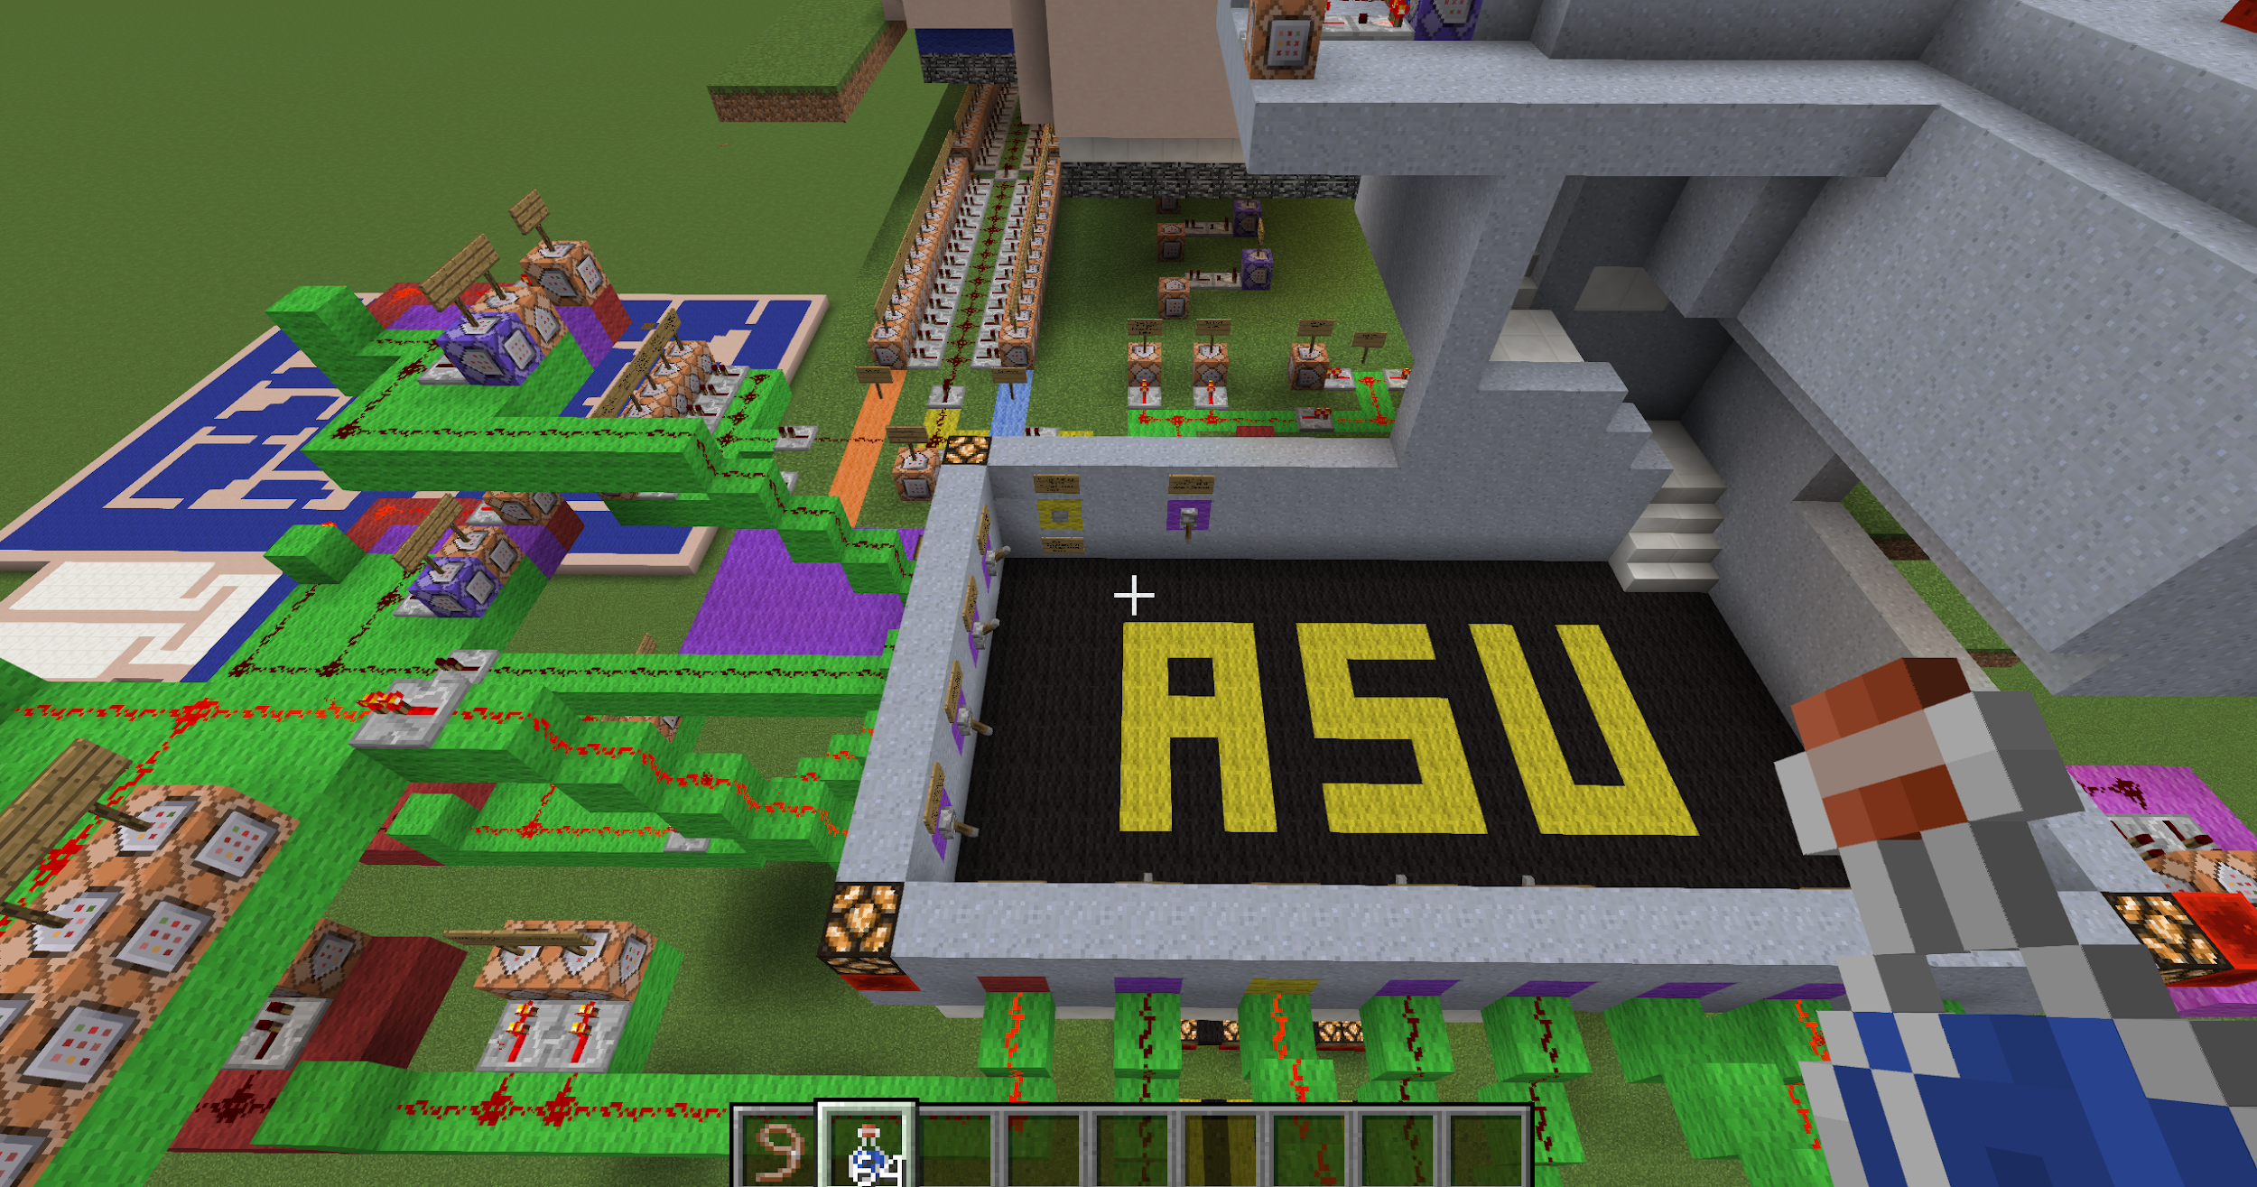
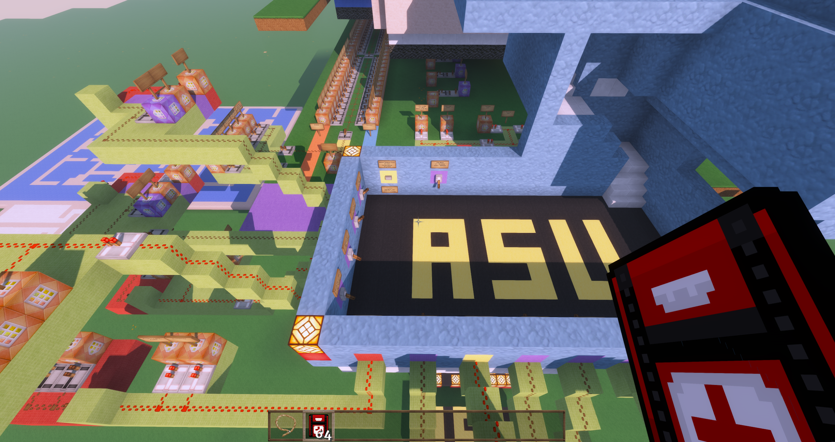
Minecraft Graphics
Default Minecraft Graphics
Texture Pack Graphics

Slide 30
Benefits of a Texture Pack
Texture packs allow for improved graphics within the Minecraft environment
Under default graphics, the First Aid Kit is actually an in-game item called “water bottle” and has the appearance of a vial with water in it
Using a texture pack, the vial was given a face lift to look like a first aid kit
Shaders can also be used in conjunction with the texture pack to give realistic lighting properties
The texture and shader pack currently in use in the screenshots will be provided in the shared drive

